Slide 1


Analysing Amazon sales data
August 9, 2024
Akshay M

Slide 2
Detailed project report
Introduction: Brief overview of the project and objectives.
Data Description: Information about the dataset and the ETL process.
Analysis: Detailed analysis with visualisations.
Findings: Key insights and relationships discovered.
Conclusion: Summary of the project and potential recommendations.

Slide 3
Introduction
Sales management has gained importance to meet increasing competition and the
need for improved methods of distribution to reduce cost and to increase profits. Sales
management today is the most important function in a commercial and business enterprise.

Slide 4
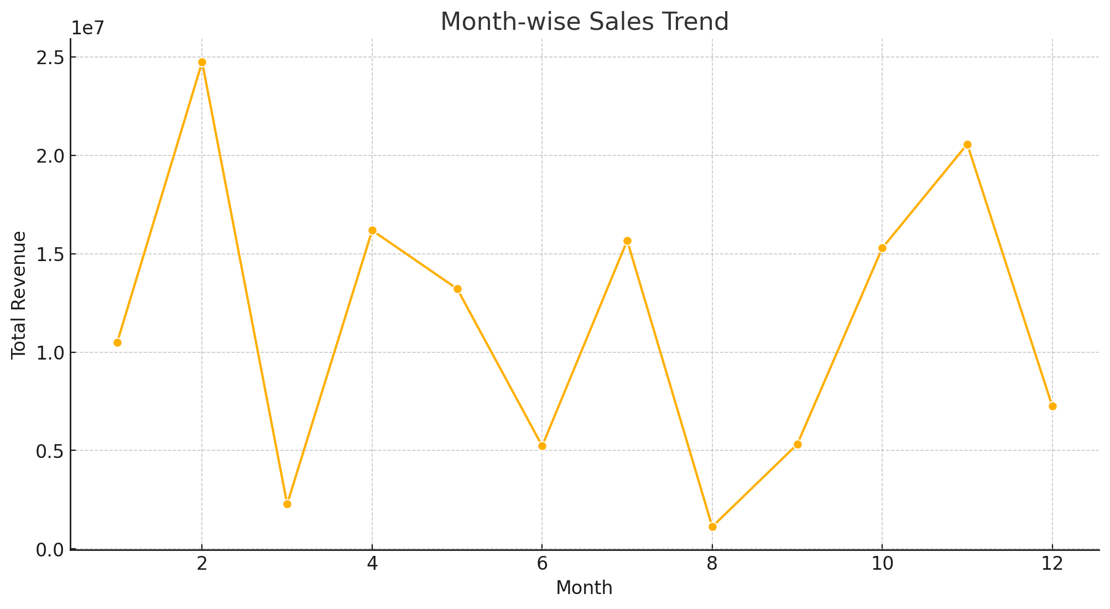
Month-Wise Sales
Graph:
In this Graph we can see that the revenue was in its peek in February and was low in August

Slide 5
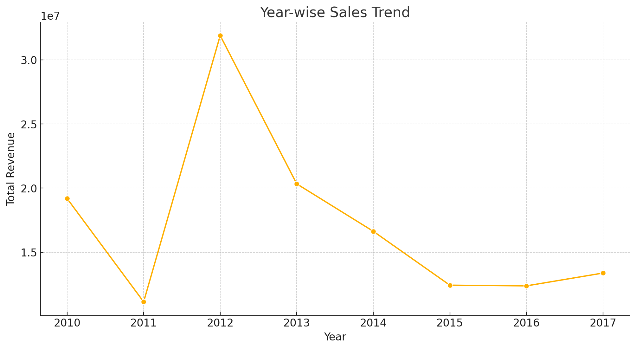
Yearly-Wise Sales
Graph:
In this Graph we can see that the revenue was in its peek in 2011-2012 and gradual declined from 2013 to 2015 and form graph we can see that form 2016 it is slightly in increase

Slide 6
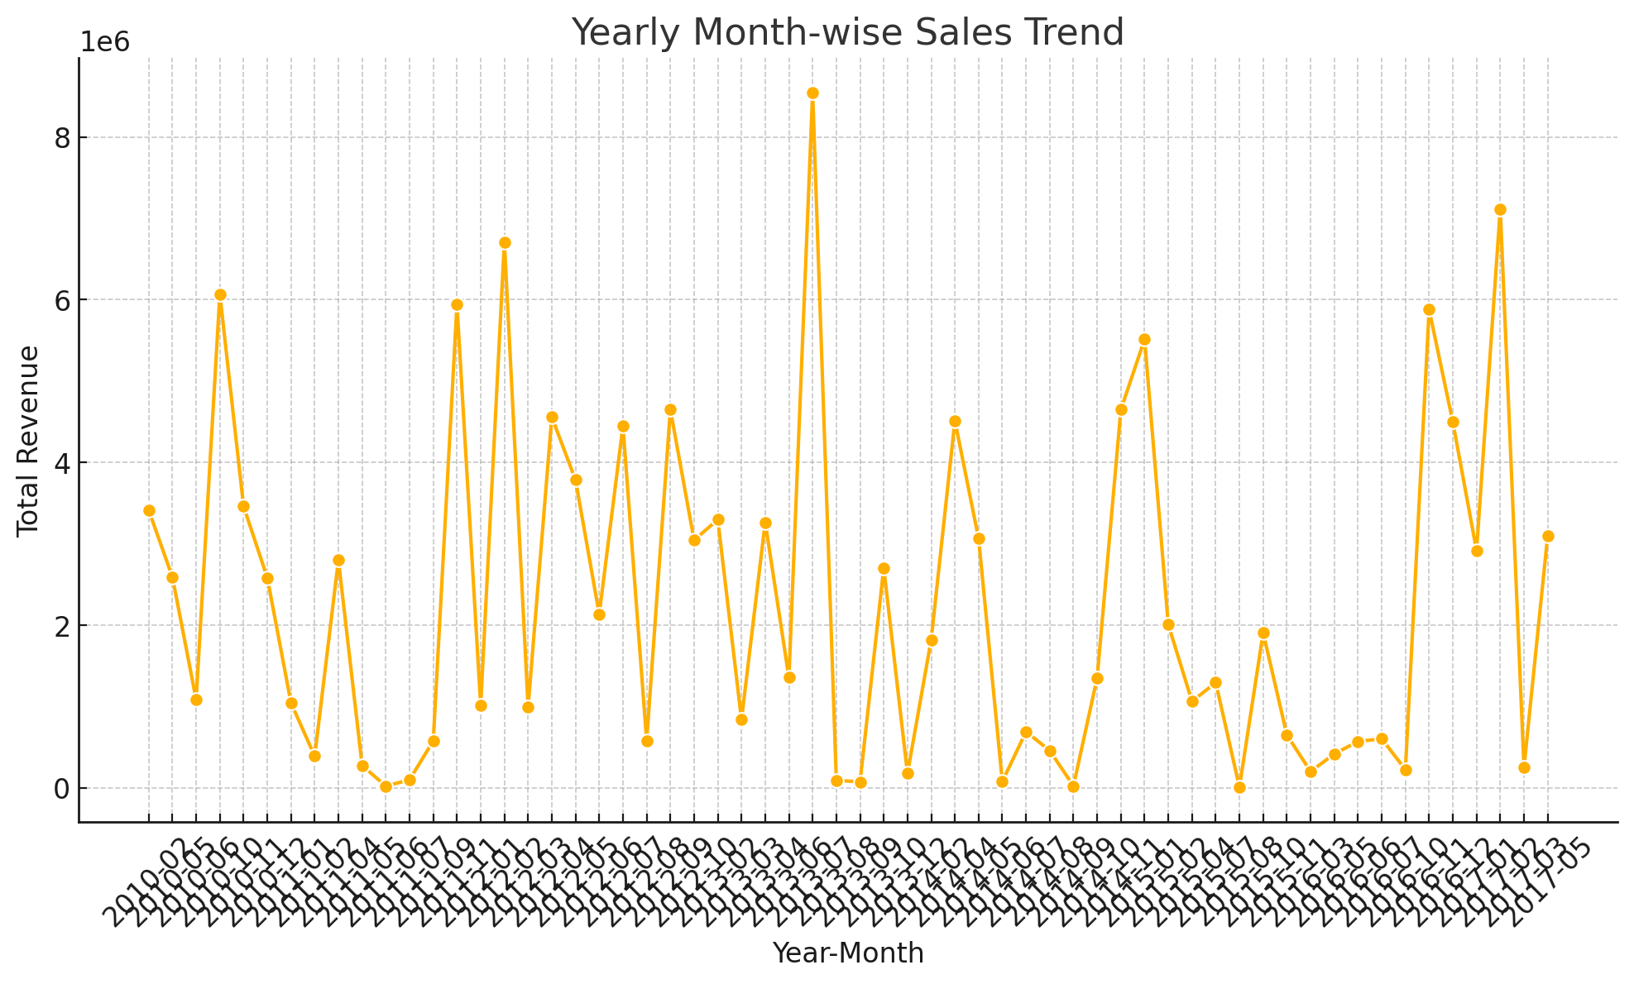
Yearly Month-Wise Sales
Graph:
In this graph we can see That the sales were all time high in march 2013 and low in may 2011 ,July 2013,2014

Slide 7
Sales Trends and Key Metrics
Month-Wise Sales Trends:
• Top Months for Revenue:
• February: $24,740,517.77
• November: $20,568,222.76
• April: $16,187,186.33
Year-Wise Sales Trends:
• Top Years for Revenue:
• 2012: $31,898,644.52
• 2013: $20,330,448.66
• 2010: $19,186,024.92

Slide 8
Yearly Month-wise Sales
Trends:
• Top Periods:
• October 2010: $6,064,933.75
• November 2011: $5,938,385.58
• November 2016: $5,876,405.20
• Key Metrics:
• Total Units Sold: 512,871 units
• Average Unit Price: $276.76
• Average Total Profit: $441,681.98

Slide 9
Findings
• Seasonality: Sales peak in November and February, indicating potential seasonal trends, possibly due to holiday shopping or promotions.
• Revenue Growth: Significant revenue spikes in 2012, suggesting potential business expansion or successful campaigns during that year.
• Profitability: Despite fluctuations in revenue, the average total profit remains robust, implying effective cost management.

Slide 10
Conclusion
1. Seasonality in Sales: Sales peak in November and February, likely due to holiday shopping or promotions. Businesses should target marketing efforts during these months to boost revenue.
2. Revenue Growth: A significant revenue spike in 2012 suggests successful marketing, product launches, or expansion.
3. Profitability: Despite revenue fluctuations, the business has maintained strong annual profits, reflecting effective cost management.
Overall, the business shows strong performance with opportunities to leverage seasonal trends and sustain profitability.

Slide 11
“Thank You”
Presented by Akshay M

